Slide 1
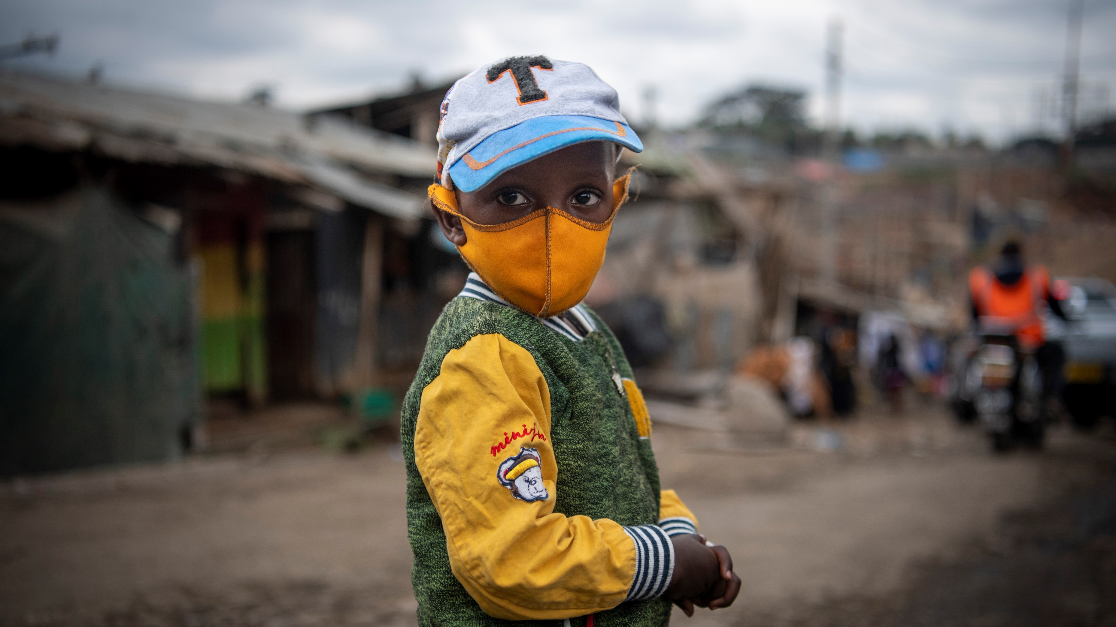

Community Rapid Assessment on COVID-19: Early Findings on Behavioral Drivers, Community Coping Mechanisms and Communication Channels in Nepal
HQ: Evaluation Office & C4D Division, ESARO: Evaluation & C4D sections, Nepal Country Office November 2020
© UNICEF/PHOTO CREDIT

Slide 2
Outline:
Community Rapid Assessment on COVID-19
Concept
Study Framework
Methodology
Analytical Approaches
Main Questions
Early Findings
Country Program Implications
Early Lessons Learned
Strengths and Limitations
2 | Community Rapid Assessment on COVID-19: Nepal

Slide 3
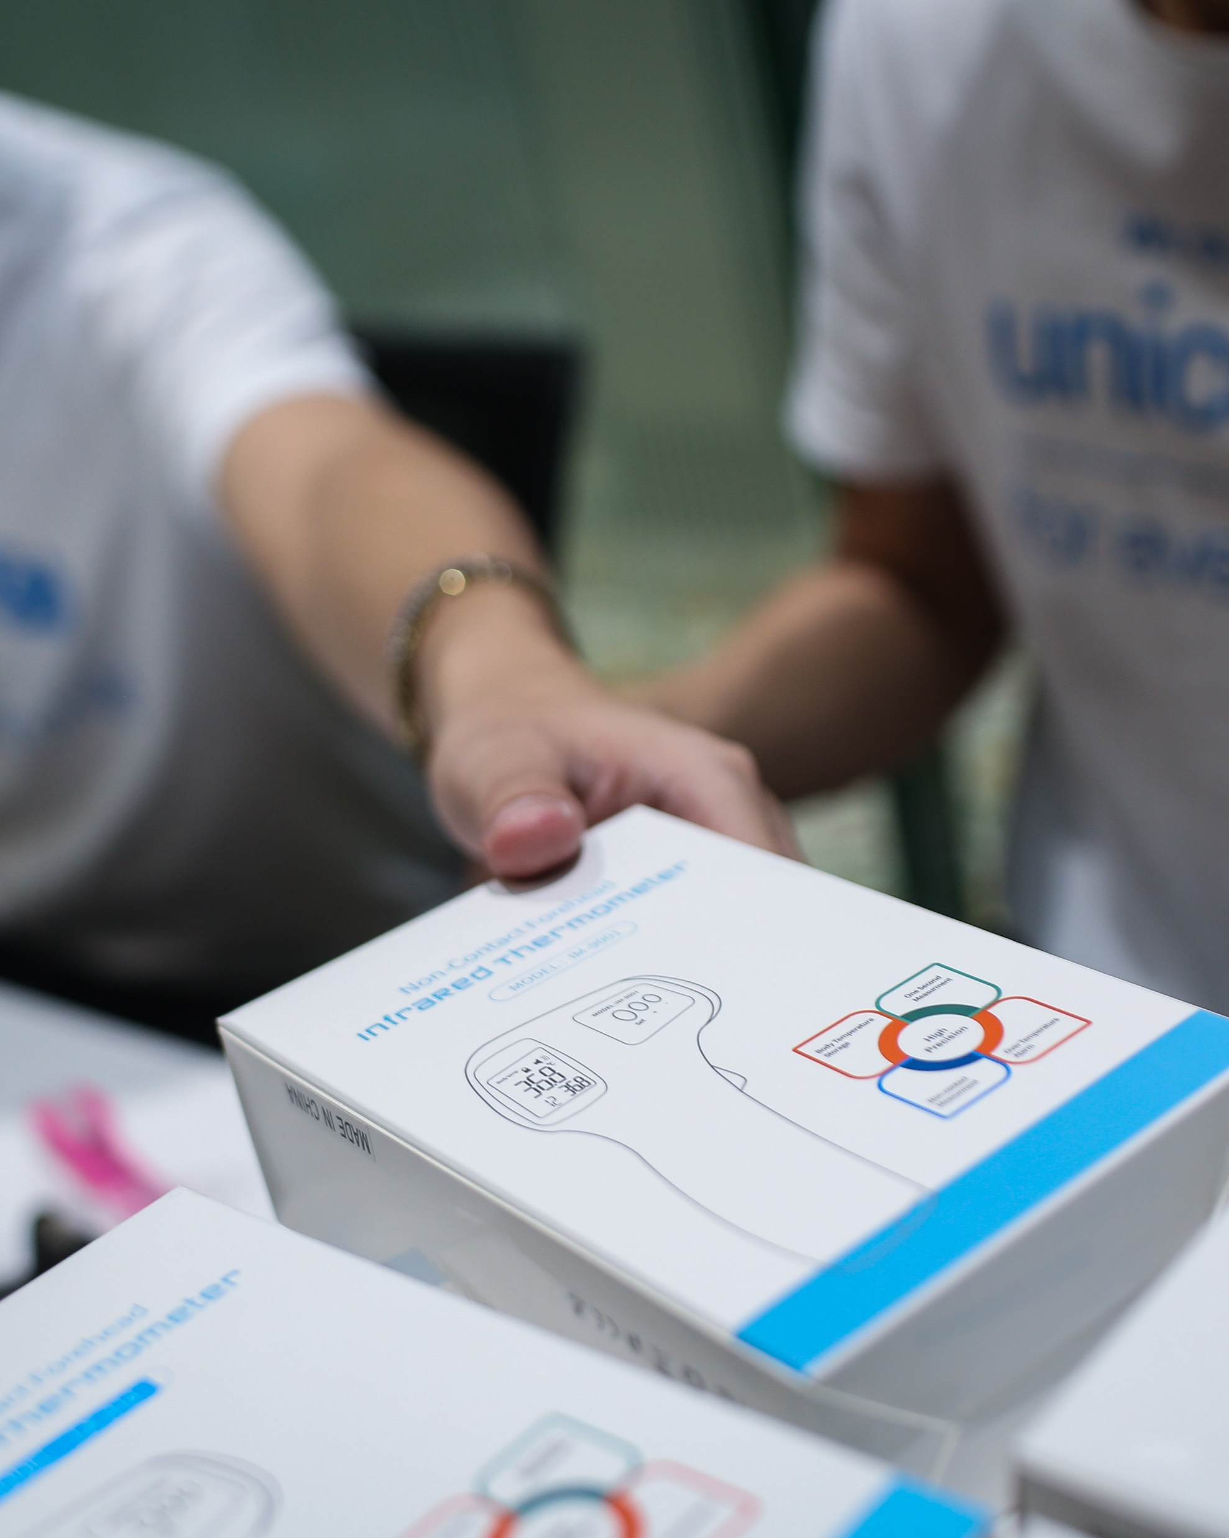
1. PROOF OF CONCEPT
A Rapid mobile-based population short survey on behavior, coping strategies and communication channels during COVID-19.
To examine behaviors and drivers using mobile phone-based population surveys in a time series in order to assess relevance and to better prepare UNICEF to address future pandemics.
To demonstrate a lightweight methodological approach that can be used in other sectors with a relatively small budget envelope.
To routinely use social and behavioral population surveys as part of a data source in understanding the organizations effectiveness, relevance, etc., in evaluation designs.
© UNICEF/PHOTO CREDIT
Find Concept Note here
3 | Community Rapid Assessment on COVID-19: Nepal

Slide 4
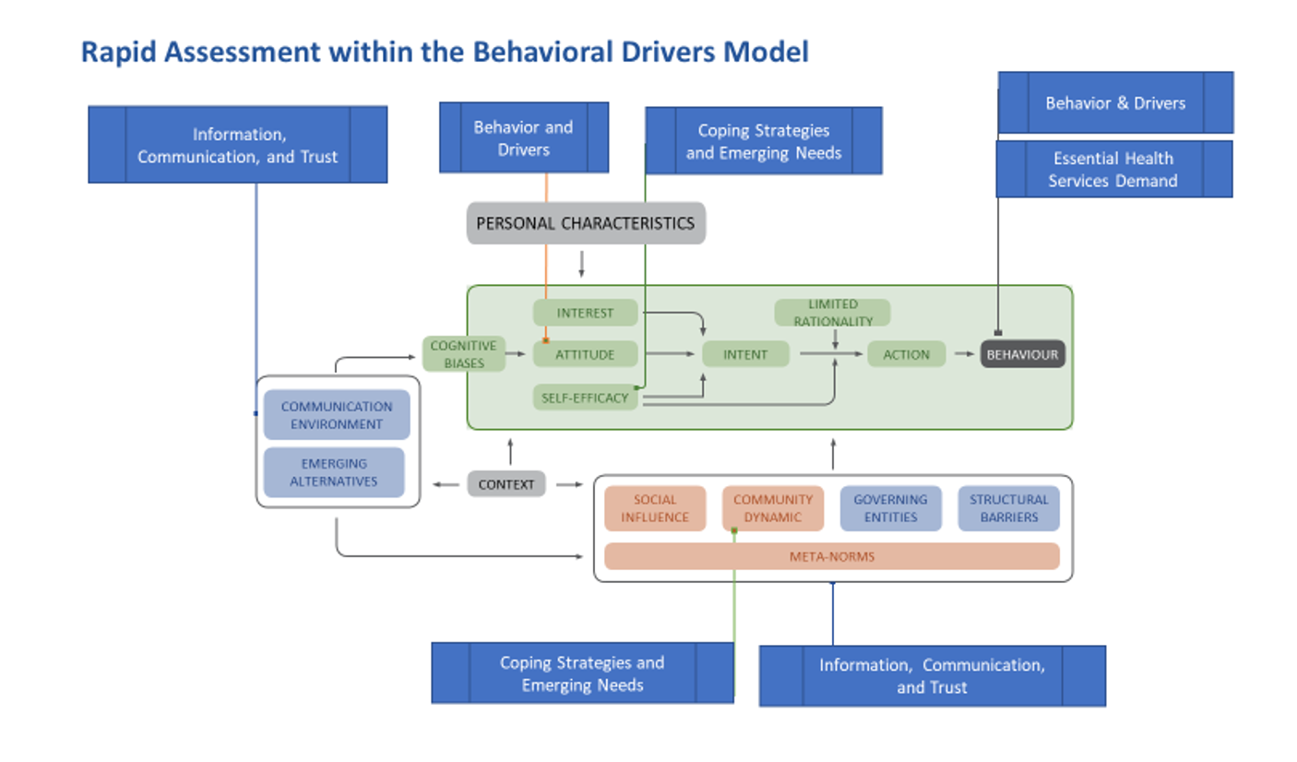
2. STUDY FRAMEWORK
To use population mobile-phone based surveying methods to examine behavioral changes, coping strategies, and evolving needs during the COVID-19 pandemic to inform programming and public policy efforts.
Find BDM framework here
4 | Community Rapid Assessment on COVID-19: Nepal
Notes:
On the CRA approach, you can add that it has been flexible in ESAR with trying to accommodate countries specific questions in questionnaire and also it integrated with existing KAp sudies in Madagascar and South Sudan

Slide 5

3. METHODOLOGY
Data Collection Modalities
Sub-sample of randomly selected households from large panel
IVR
Paper based
Data Type: Quantitative, repeated cross-sectional time series.
Periodicity: Multiple rounds planned for 1-2 month
Geographic Coverage: National and sub-national
Sampling & Sample Size: Probabilistic; ~N= +1,000
Instrument: Short quantitative survey with standardized questions with room for country adaptation (Max 24 questions)
Demographic variables:
a) Sex,
b) Age,
c) Education, and
d) Area of Residence
Quality Control
Pre-survey testing
Methodological review of instruments
Ex-Post facto sample weighting**
Country-Level Summary
Country | Survey Size | Modality | CRA Type
Nepal | n = 6675 | Phone Survey | 6 Rounds
5 | Community Rapid Assessment on COVID-19: Nepal
Find CRA ESARO Model questionnaire here

Slide 6
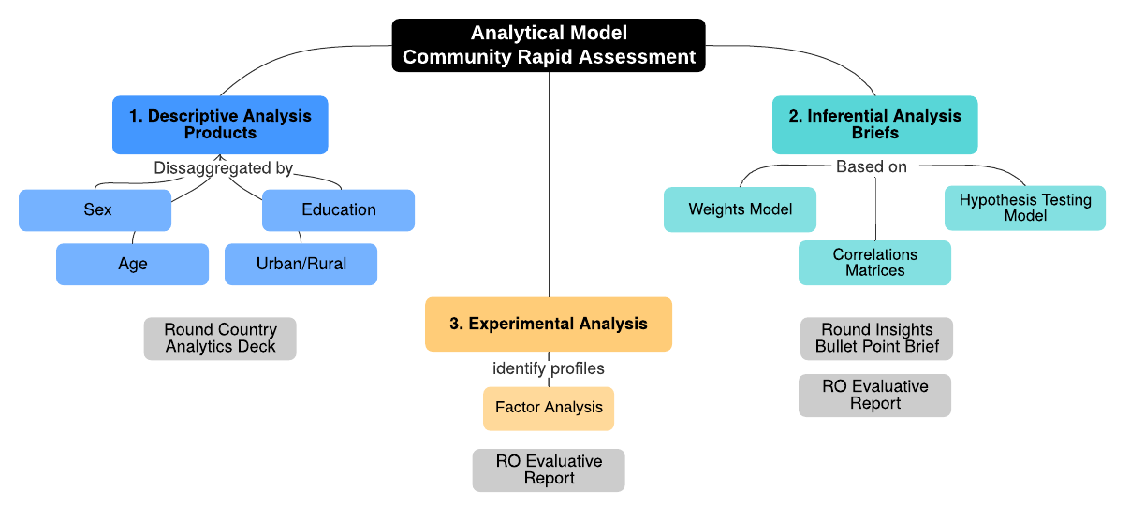
4. ANALYTICAL APPROACH
Principles:
Rapid deployment
Key insights focus on behaviors and drivers
Rigorous but flexible approach (including exploratory and non-parametric approaches)
For this review, we will:
Focus on key variables and look at comparisons across countries and groups
Highlight insights for program application
Find CRA Analytic Plan here
6 | Community Rapid Assessment on COVID-19: Nepal

Slide 7
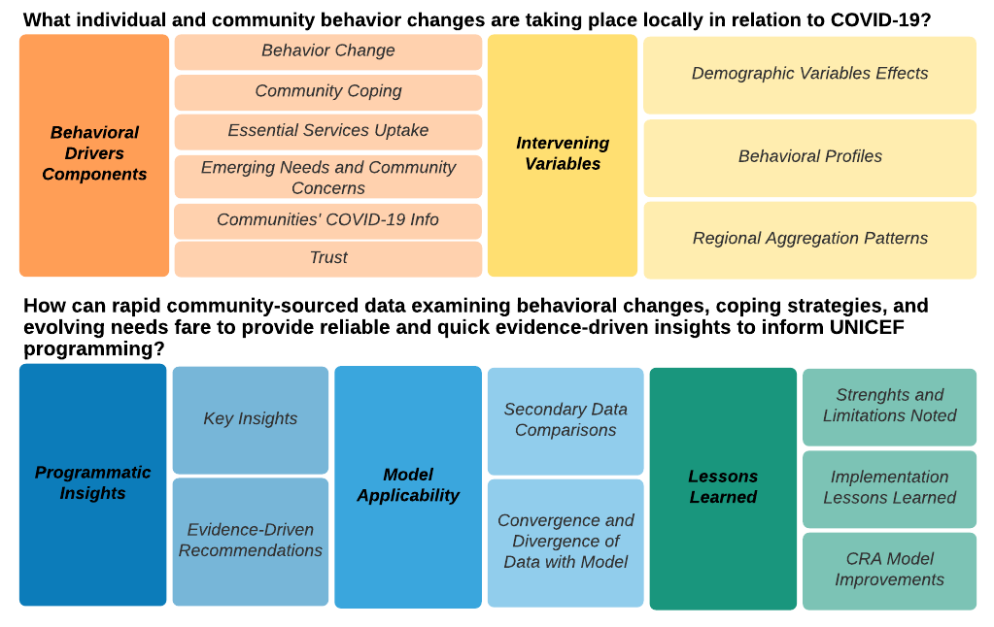
5. MAIN QUESTIONS
For these early results, we will:
Review selected key findings
Compare across countries, where possible
Highlight insights and areas for further analyses
7 | Community Rapid Assessment on COVID-19: Nepal

Slide 8
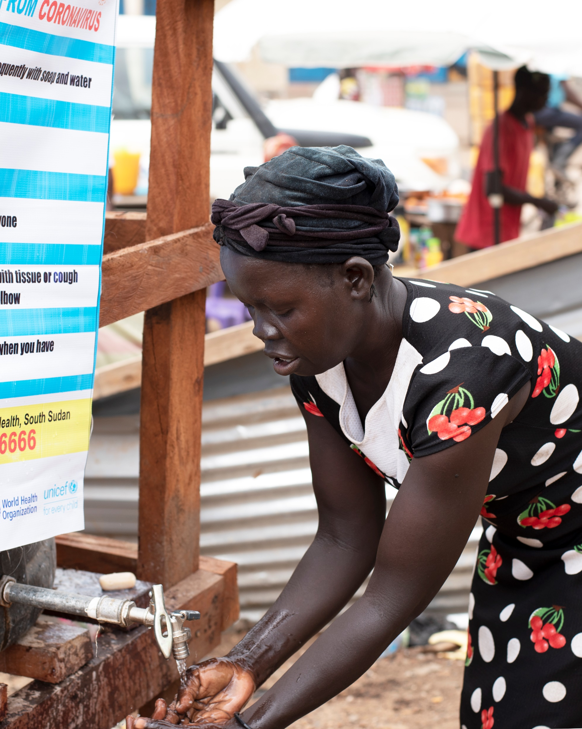
6. EARLY FINDINGS:
What are the current behavioral practices taking place in relation to COVID-19?
© UNICEF/PHOTO CREDIT
8 | Community Rapid Assessment on COVID-19: Nepal

Slide 9
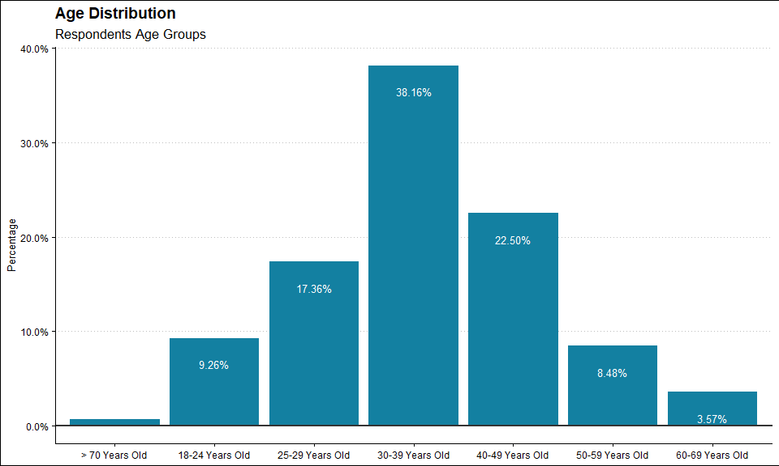
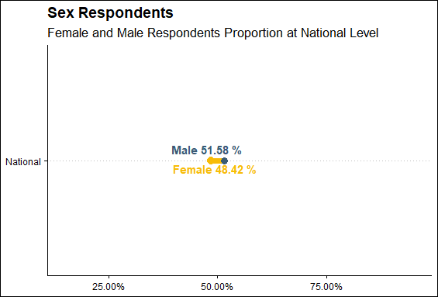
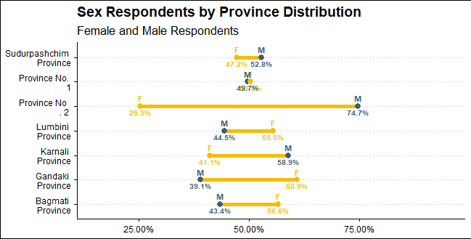
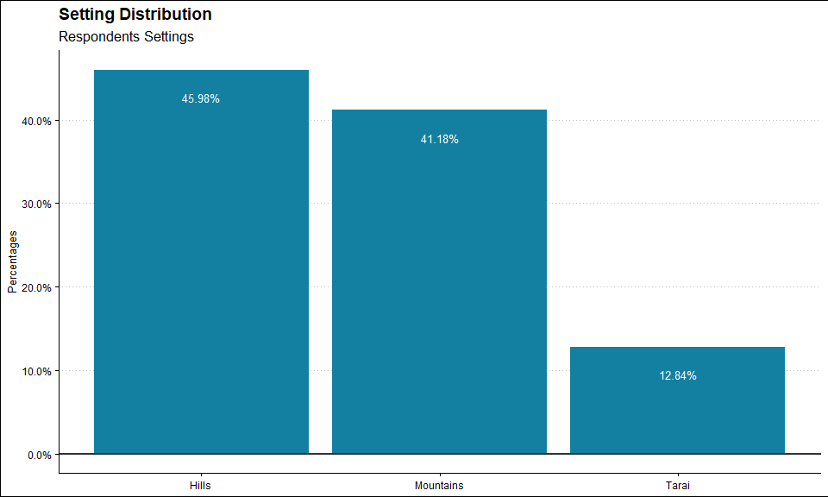
DEMOGRAPHICS
9 | Community Rapid Assessment on COVID-19: Nepal

Slide 10
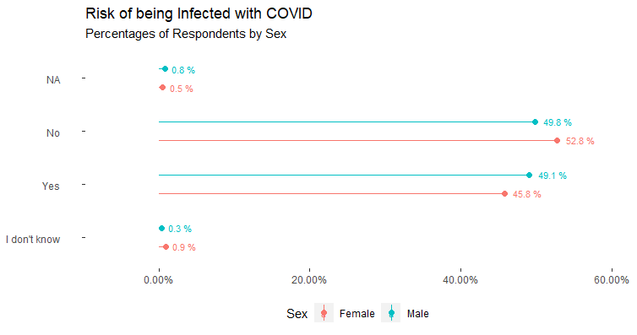
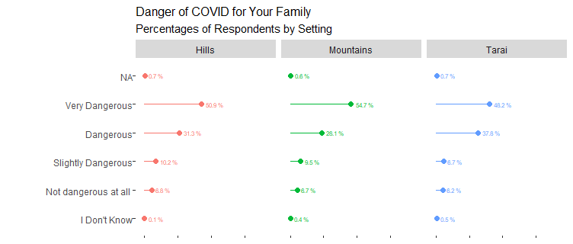
What are the risk perceptions and barriers communities have during COVID-19?
10 | Community Rapid Assessment on COVID-19: Nepal

Slide 11
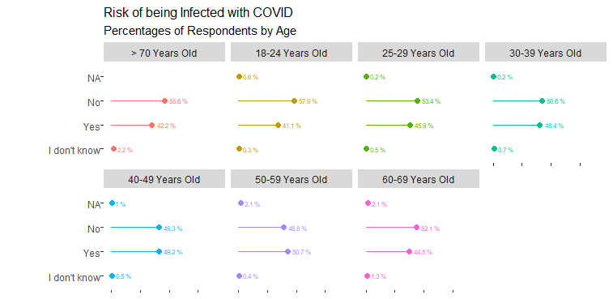
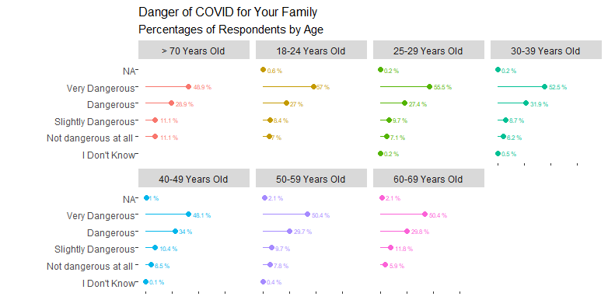
What are the risk perceptions and barriers communities have during COVID-19?
11 | Community Rapid Assessment on COVID-19: Nepal

Slide 12
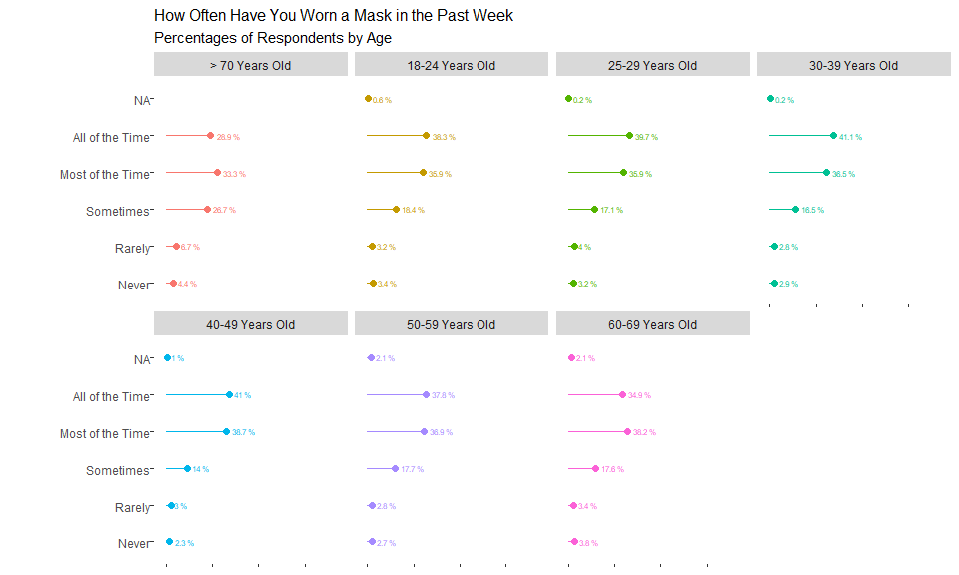
What are communities doing to protect themselves from COVID-19?
12 | Community Rapid Assessment on COVID-19: Nepal

Slide 13
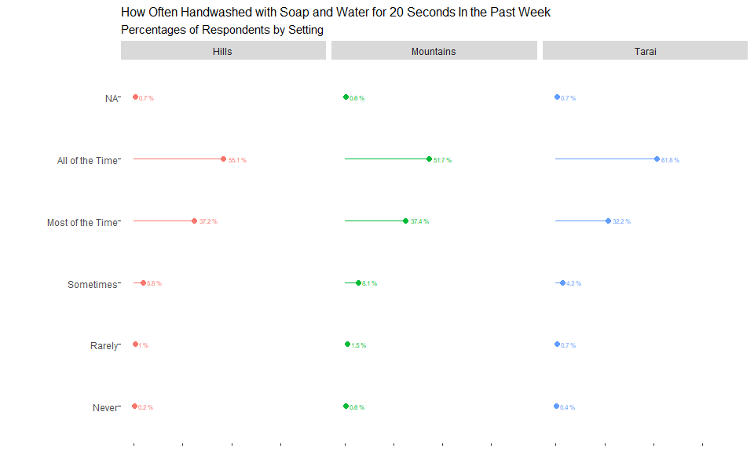
What are communities doing to protect themselves from COVID-19?
13 | Community Rapid Assessment on COVID-19: Nepal

Slide 14
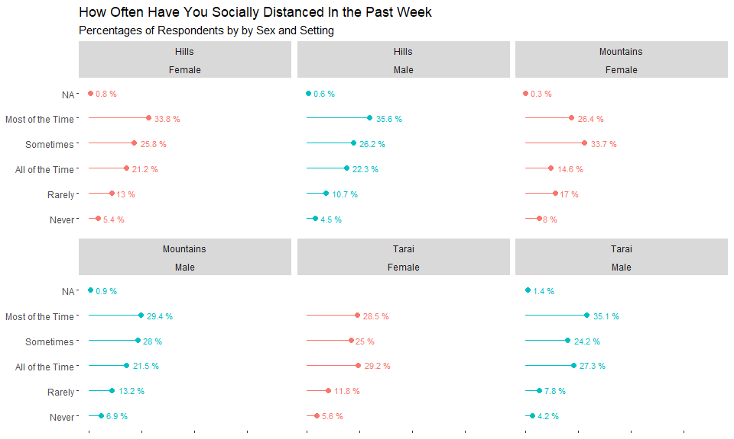
What are communities doing to protect themselves from COVID-19?
14 | Community Rapid Assessment on COVID-19: Nepal

Slide 15
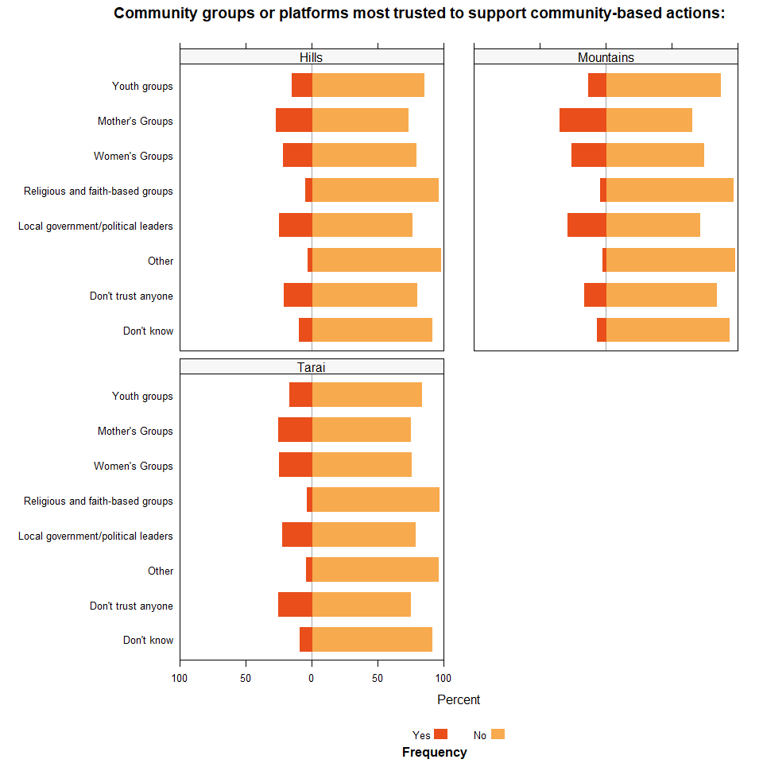
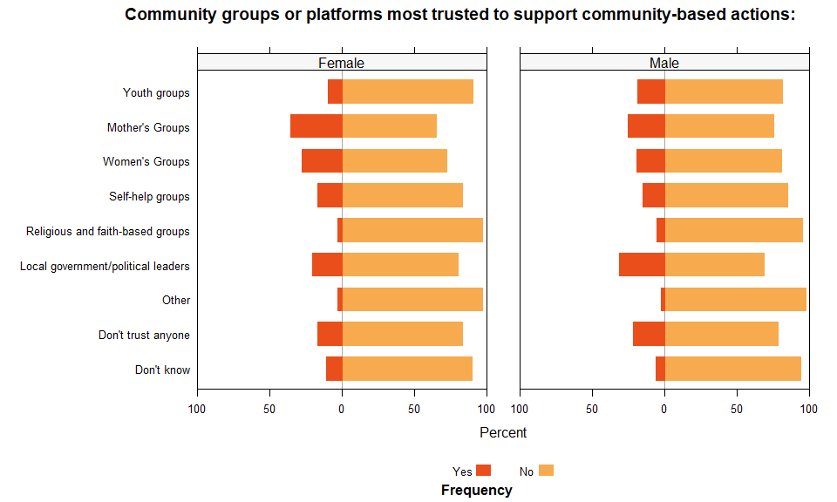
What are communities doing to protect themselves from COVID-19?
15 | Community Rapid Assessment on COVID-19: Nepal

Slide 16
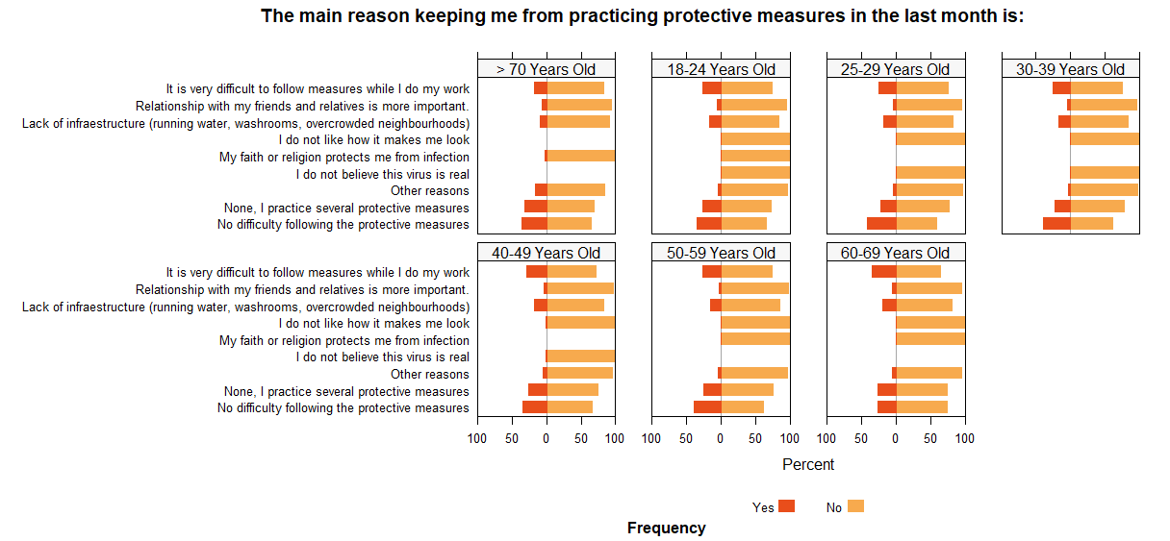
What are communities doing to protect themselves from COVID-19?
16 | Community Rapid Assessment on COVID-19: Nepal

Slide 17
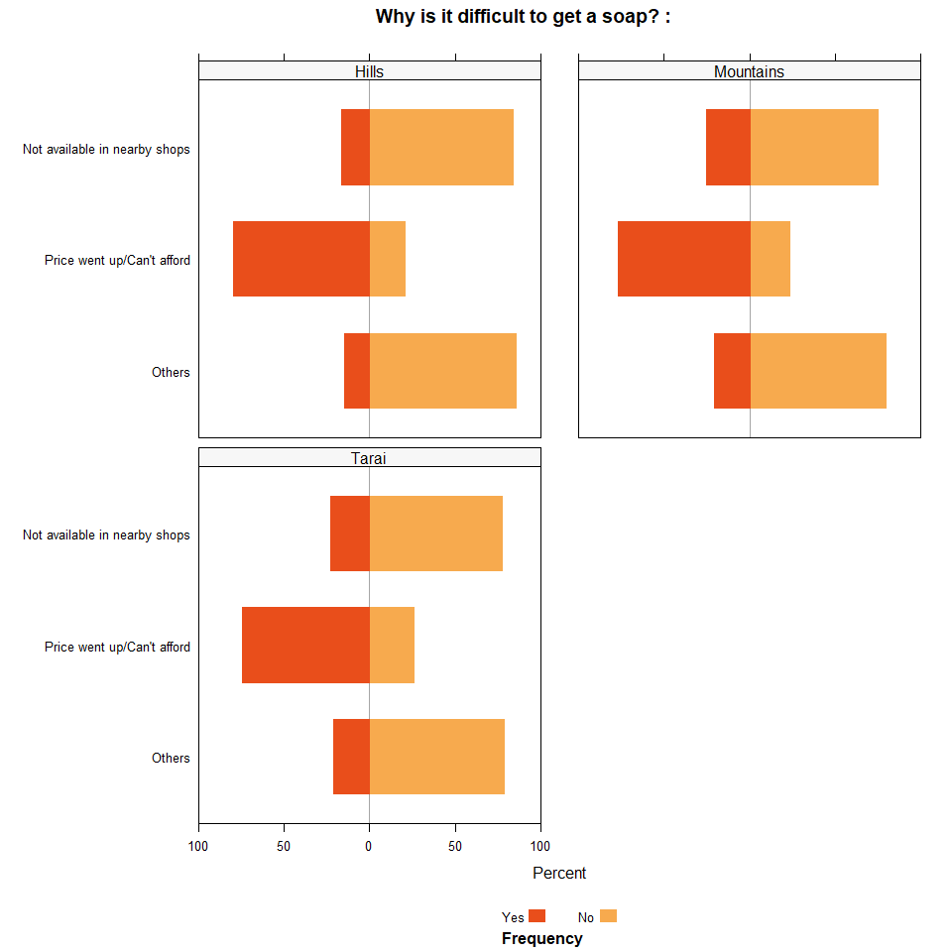
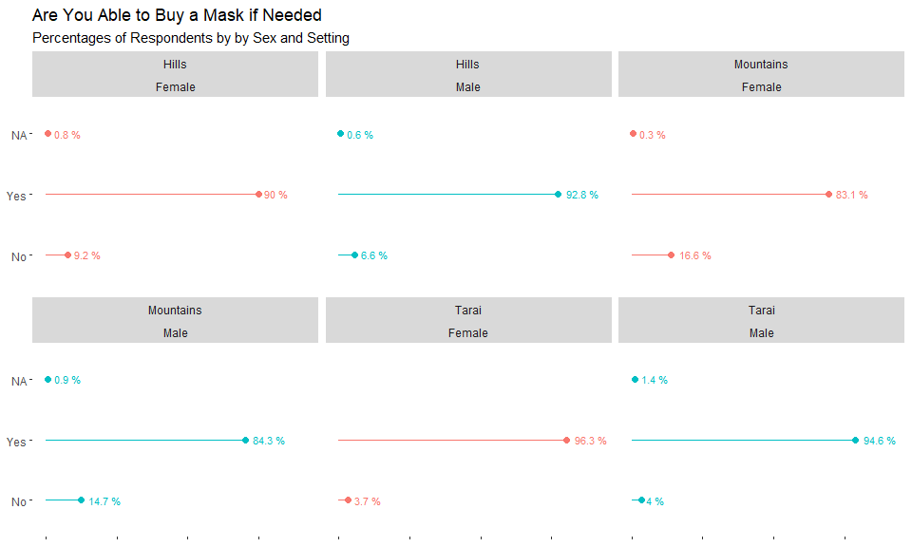
How communities see access to essential services during COVID-19?
17 | Community Rapid Assessment on COVID-19: Nepal

Slide 18
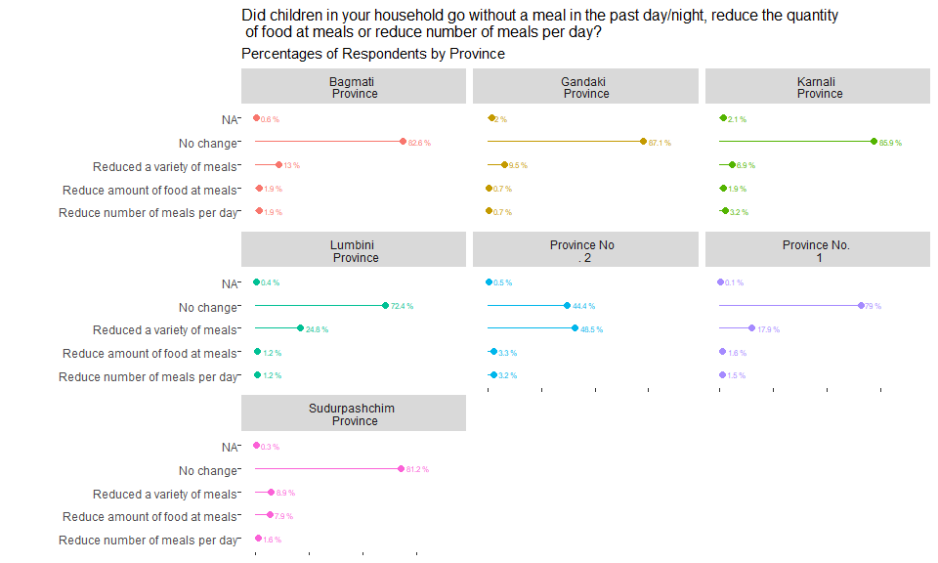
What are the emerging needs and concerns of the community?
18 | Community Rapid Assessment on COVID-19: Nepal

Slide 19
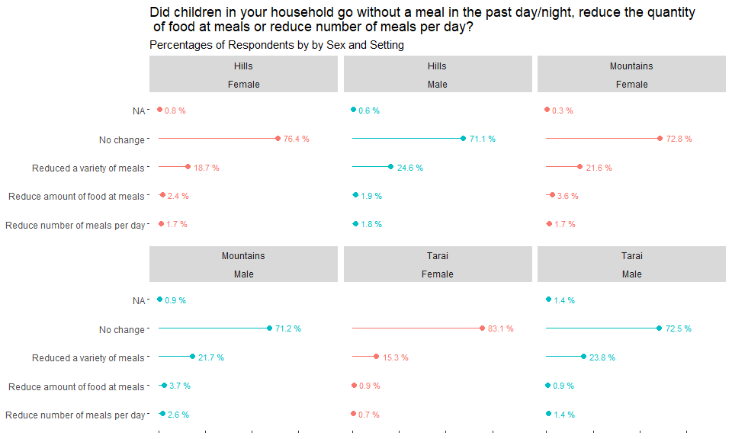
What are the emerging needs and concerns of the community?
19 | Community Rapid Assessment on COVID-19: Nepal

Slide 20
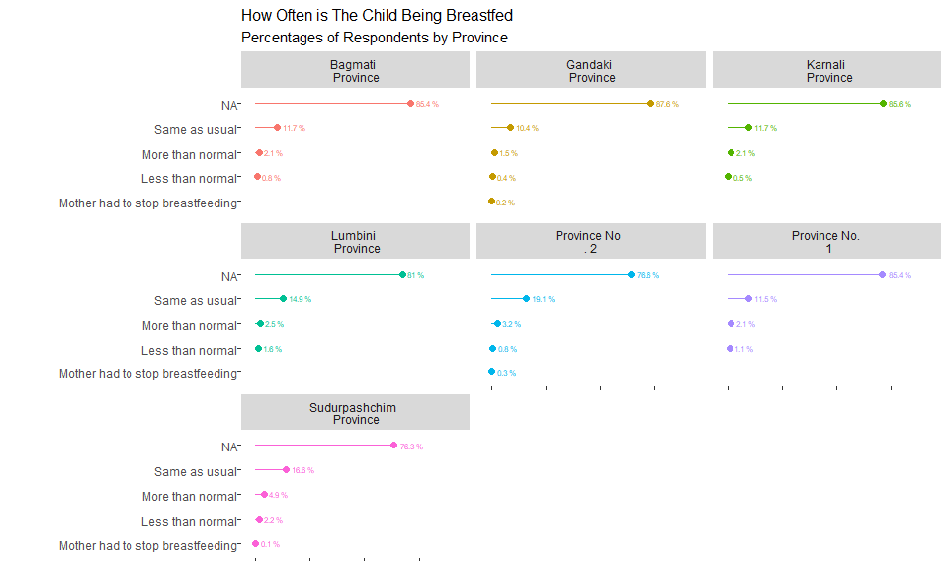
What are the emerging needs and concerns of the community?
20 | Community Rapid Assessment on COVID-19: Nepal

Slide 21
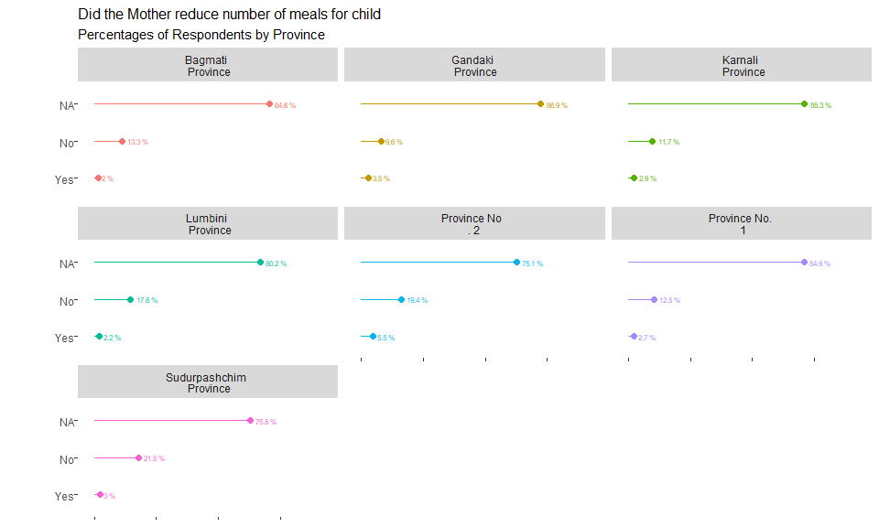
What are the emerging needs and concerns of the community?
21 | Community Rapid Assessment on COVID-19: Nepal

Slide 22
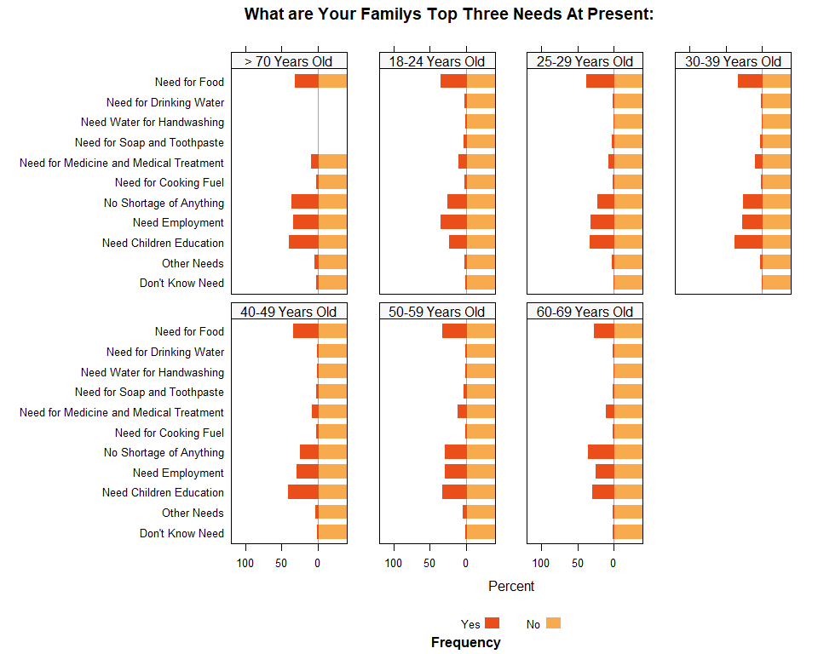
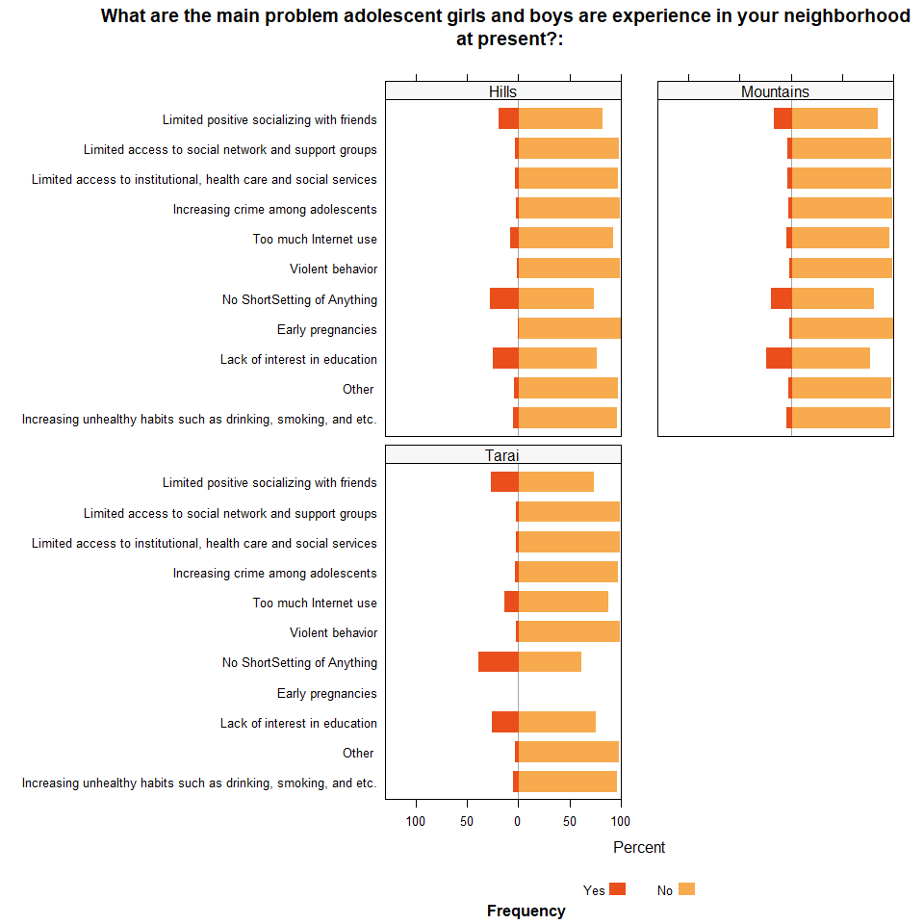
What are the emerging needs and concerns of the community?
22 | Community Rapid Assessment on COVID-19: Nepal

Slide 23
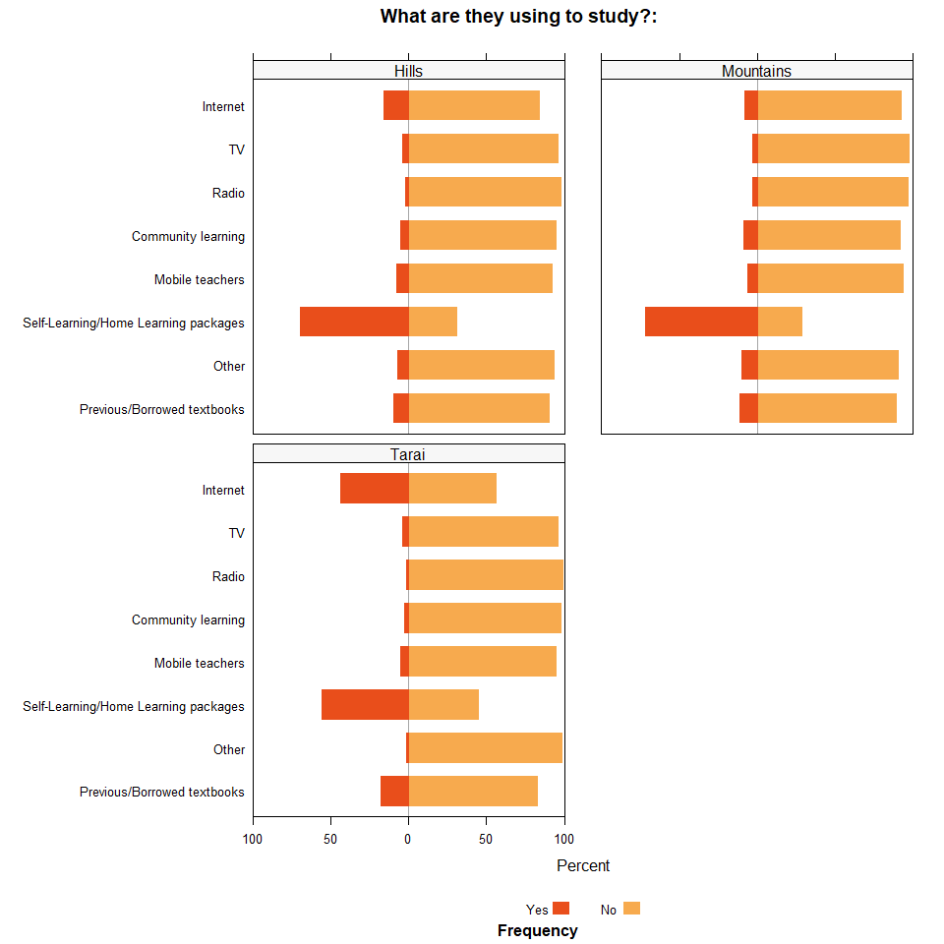
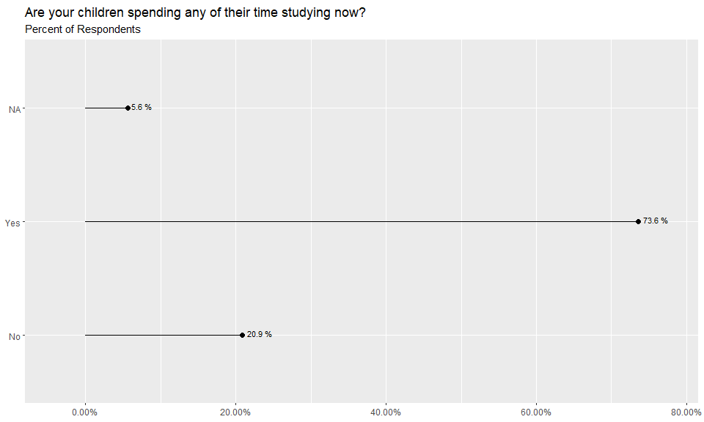
What are the emerging needs and concerns of the community?
23 | Community Rapid Assessment on COVID-19: Nepal

Slide 24
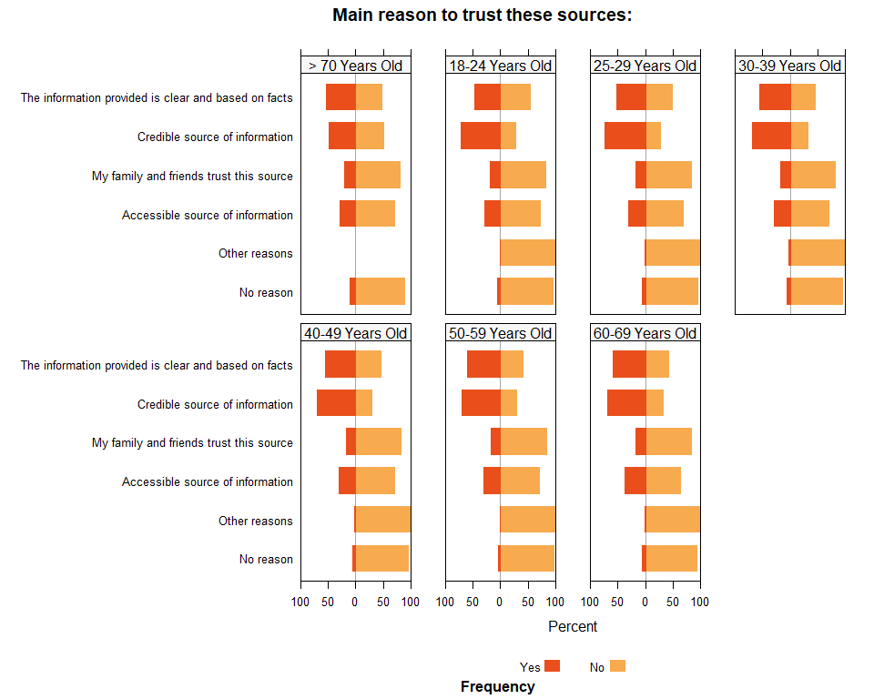
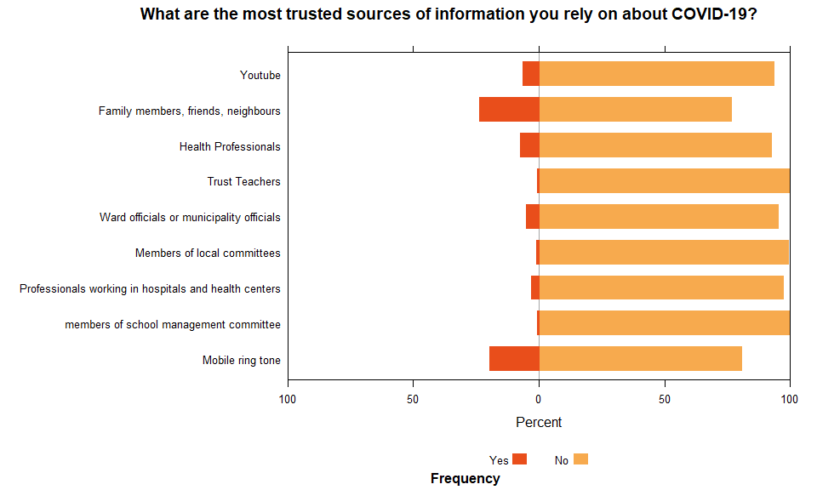
How are communities receiving their COVID-19 information?
24 | Community Rapid Assessment on COVID-19: Nepal

Slide 25
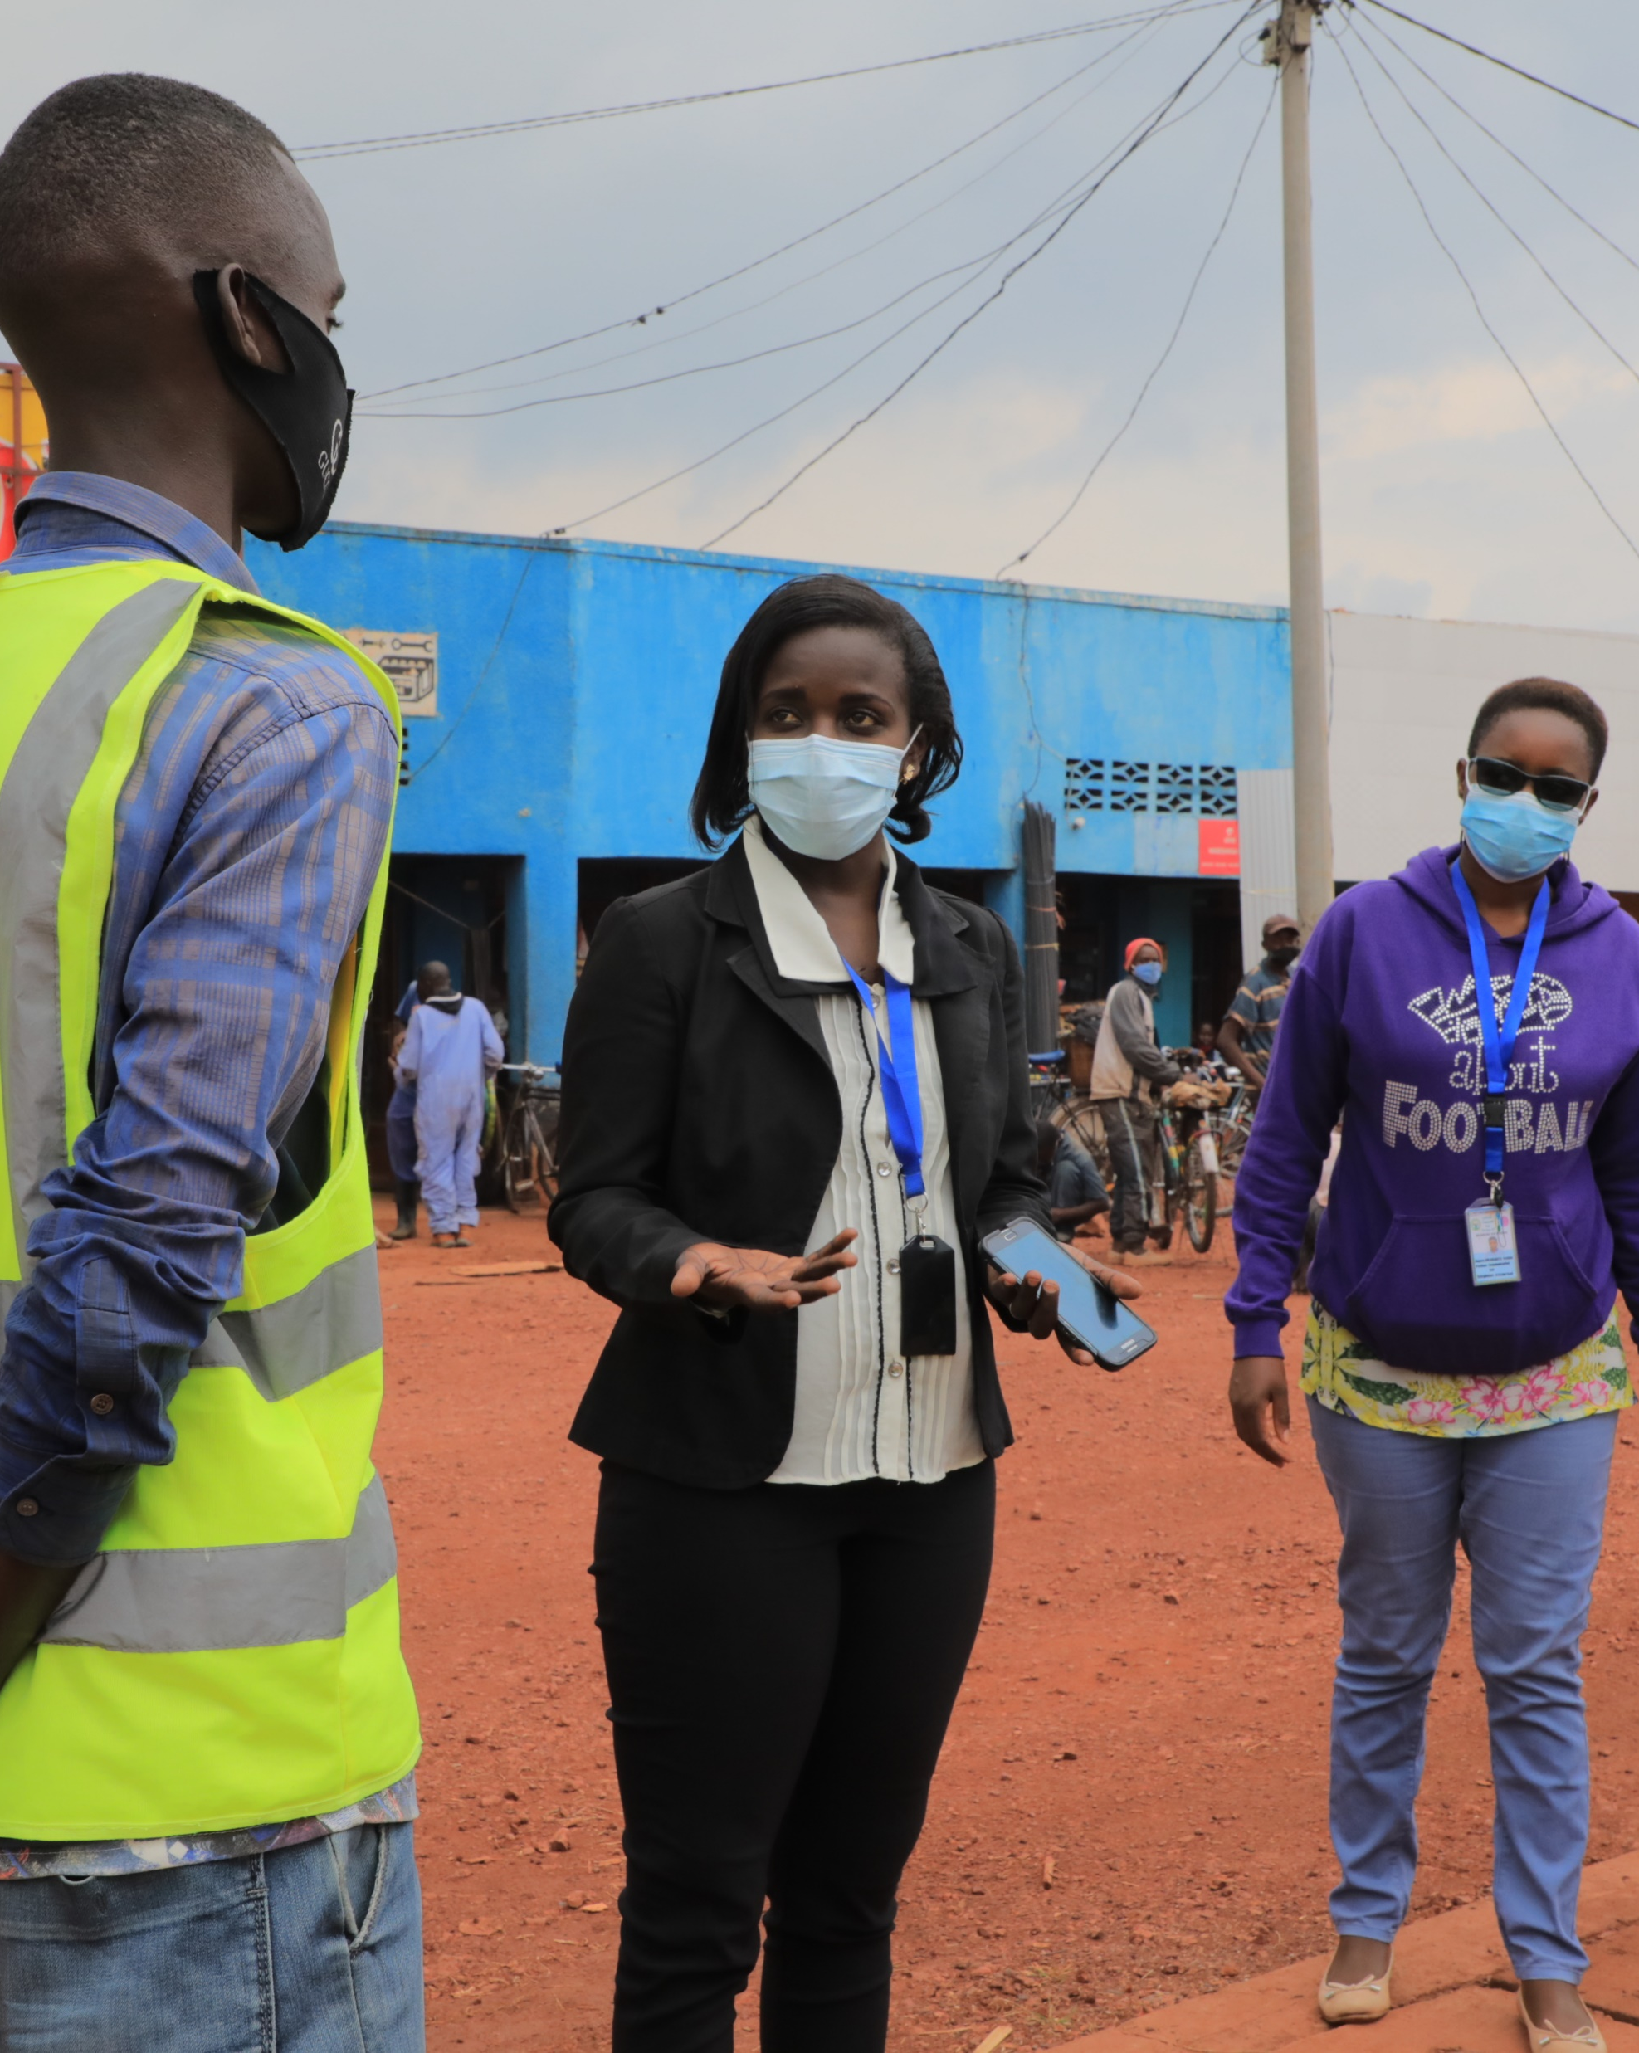
7. Findings: How can rapid community-sourced data provide reliable and quick evidence-driven insights to inform UNICEF programming?
Program Implications for Nepal
© UNICEF/PHOTO CREDIT
25 | Community Rapid Assessment on COVID-19: Nepal

Slide 26
NEPAL: Key Takeaways
Differences across demographics: There are some differences between age groups and for area of residence in terms of protective practices, access to services, and emerging needs.
Barriers: Structural barriers and work related constrains seem to be some of the driving factors reducing the number of respondents that can practice protective behaviors. These appear to be more salient depending of area of residence and province.
Sources of information: There are apparent different communication profiles as to which are the most effective COVID-19 information mechanism to reach respondents, especially related to age.
Coping Mechanisms: There are relatively small percentage of respondents who have had food and nutrition impact However, there is much variation across groups. For example in breastfeeding the lowest rate for a province is 0.8% where a mother breastfeeds less than normal but in some instances it increases to more than 2% of respondents.
26 | Community Rapid Assessment on COVID-19: Nepal

Slide 27
NEPAL: Key Takeaways (continued)
Community groups trusted: There also appear to be different trust levels to different community groups depending of the residence and age. This will further help identify not only communication most effective channels but also more likely to be trusted community partners for COVID-19 programming.
Risk Perception: Risk perception also varies across gender and area of residence and area likely to also be influencing protective behaviors and likely levels of trust.
Significant differences: For next steps it will be important to test whether or not these observables differences are significant with each other and to also weight the distribution of the sample to better portray how the pool of respondents represent how the national population is experiencing the related surveyed areas.
27 | Community Rapid Assessment on COVID-19: Nepal

Slide 28
NEPAL: Program Implications, Use and Uptake
1. How have you used, or will you use insights generated by this first round of data collection to improve current CO responses to COVID-19?
2. What is missing?
28 | Community Rapid Assessment on COVID-19: Nepal

Slide 29
NEPAL: Program Implications, Use and Uptake
2. What are some of the lessons learned about the method and questionnaire used during this first round of data collection?
3. What are the most critical population data needs for UNICEF C4D and governments to act on at this stage in the pandemic?
4. What are the critical behaviors that will need to be observed during the pandemic?
29 | Community Rapid Assessment on COVID-19: Nepal

Slide 30
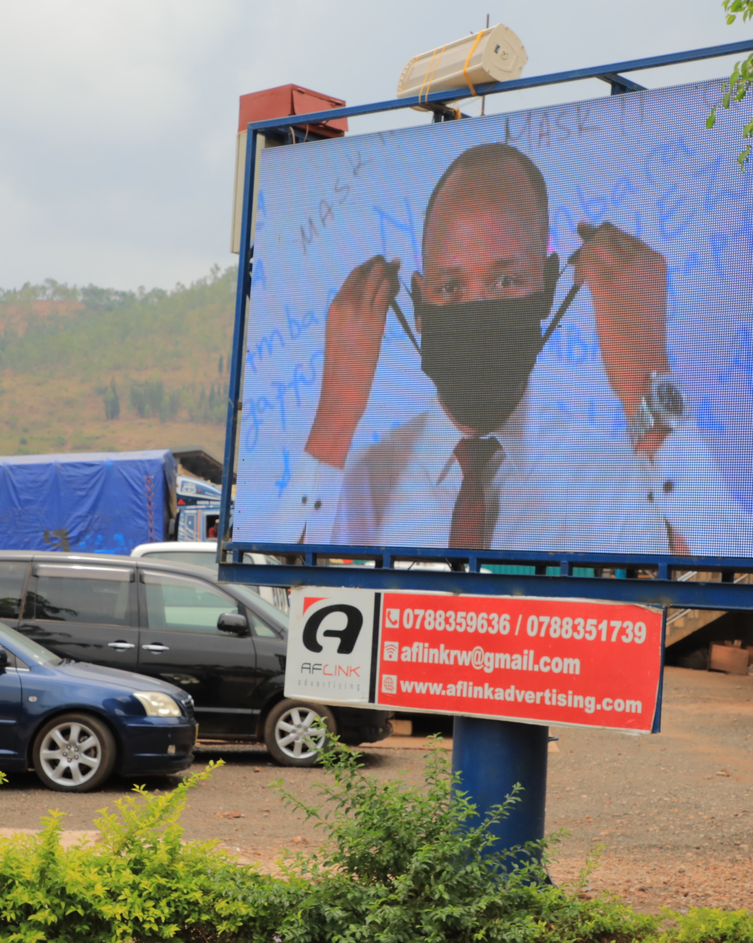
8. Early Lessons Learned
Identifying differences between demographic groups and their driving factors to enhance RCCE programming and fine-tune interventions
Difference on protective practices can help pinpoint issues on interventions and support areas to increase usage rates, including identifying issues of availability of protective gear
Identifying the trusted Community Groups and Information Channels helps strengthen community programming
Triangulating and contextualizing CRA information with qualitative data, especially field observations can give a very valuable picture of the situation
© UNICEF/PHOTO CREDIT
30 | Community Rapid Assessment on COVID-19: Nepal

Slide 31
9. Strengths and Limitations
Strengths:
Quick adaptation of survey to country needs especially in emergencies. Phones allow for quick and flexible changes in questions.
Reduced costs and time when compared to other alternatives (vs. Paper Based)
Standardization facilitates analysis and design
Sources data directly from individuals rather than head of households
Richness of cross-tabular analysis with available demographic variables (Hypothesis testing needed)
Temporal element provides richer narrative of evolving situation.
BDM strong adaptability across sectors
Short surveys in time series allows for quicker results iteration of interventions or strategies.
Limitations:
Limited demographic insights due to absence of gender variable
Survey length using phones limits extent of investigation.
Variable airtime costs and phone penetration rates may skew representativeness of population.
Limited aggregation and comparability at regional level due to heterogeneity of surveys
Absence of comparable studies
Generalized difficulty to integrate different surveys to contrast results
Observational effect on self-reporting questions on ‘practices’ (Desirability Bias)
Demand for adequate analytical capacity across the organization if such high frequency systems are in place.
31 | Community Rapid Assessment on COVID-19: Nepal

Slide 32

Thank you.
© UNICEF/UN0216133
32 | Community Rapid Assessment on COVID-19: Nepal

Slide 33
References
Petit, V. (2019). The Behavioural Drivers Model: A Conceptual Framework for Social and Behaviour Change Programming. UNICEF.
Croke, Kevin, et al. “Collecting High Frequency Panel Data in Africa Using Mobile Phone Interviews.” Policy Research Working Papers, 2012, doi:10.1596/1813-9450-6097
Deborah Toppenberg-Pejcic, Jane Noyes, Tomas Allen, Nyka Alexander, Marsha Vanderford & Gaya Gamhewage (2019) Emergency Risk Communication: Lessons Learned from a Rapid Review of Recent Gray Literature on Ebola, Zika, and Yellow Fever, Health Communication, 34:4, 437-455, DOI: 10.1080/10410236.2017.1405488
Durbin, Will, et al. “Chapter 3:Using Mobile Phones for High-Frequency Data Collection.” Mobile Research Methods: Opportunities and Challenges of Mobile Research Methodologies, by Daniele Toninelli et al., Ubiquity Press, 2015
Gamma, Anna E., et al. “The Impact of Various Promotional Activities on Ebola Prevention Behaviors and Psychosocial Factors Predicting Ebola Prevention Behaviors in the Gambia Evaluation of Ebola Prevention Promotions.” International Journal of Environmental Research and Public Health, vol. 16, no. 11, 2019, p. 2020., doi:10.3390/ijerph16112020
Giroux, Stacey A., et al. “A High-Frequency Mobile Phone Data Collection Approach for Research in Social-Environmental Systems: Applications in Climate Variability and Food Security in Sub-Saharan Africa.” Environmental Modelling & Software, vol. 119, 2019, pp. 57–69., doi:10.1016/j.envsoft.2019.05.011
33 | Community Rapid Assessment on COVID-19: Nepal

Slide 34
References (continued)​
Grantz, K.H., Meredith, H.R., Cummings, D.A.T. et al. The use of mobile phone data to inform analysis of COVID-19 pandemic epidemiology. Nat Commun 11, 4961 (2020). https://doi.org/10.1038/s41467-020-18190-5
Jacobsen, Kathryn H., et al. “Lessons from the Ebola Outbreak: Action Items for Emerging Infectious Disease Preparedness and Response.” EcoHealth, vol. 13, no. 1, 2016, pp. 200–212., doi:10.1007/s10393-016-1100-5
Li, Jingtao, et al. “Behaviors of High-Frequency Subscribers in Cellular Data Networks.” Security and Communication Networks, vol. 2018, 2018, pp. 1–12., doi:10.1155/2018/2506319 ​
Milusheva, Sveta. “Using Mobile Phone Data to Reduce Spread of Disease.” Policy Research Working Papers, 2020, doi:10.1596/1813-9450-9198. ​
Oliver, Nuria, et al. “Mobile Phone Data for Informing Public Health Actions across the COVID-19 Pandemic Life Cycle.” Science Advances, vol. 6, no. 23, 2020, doi:10.1126/sciadv.abc0764​
Winters, Maike, et al. “Risk Communication and Ebola-Specific Knowledge and Behavior during 2014–2015 Outbreak, Sierra Leone.” Emerging Infectious Diseases, vol. 24, no. 2, 2018, pp. 336–344., doi:10.3201/eid2402.171028
Zhang, Liwei, et al. “Effective Risk Communication for Public Health Emergency: Reflection on the COVID-19 (2019-NCoV) Outbreak in Wuhan, China.” Healthcare, vol. 8, no. 1, 2020, p. 64., doi:10.3390/healthcare8010064
34 | Community Rapid Assessment on COVID-19: Nepal

